Slide 1
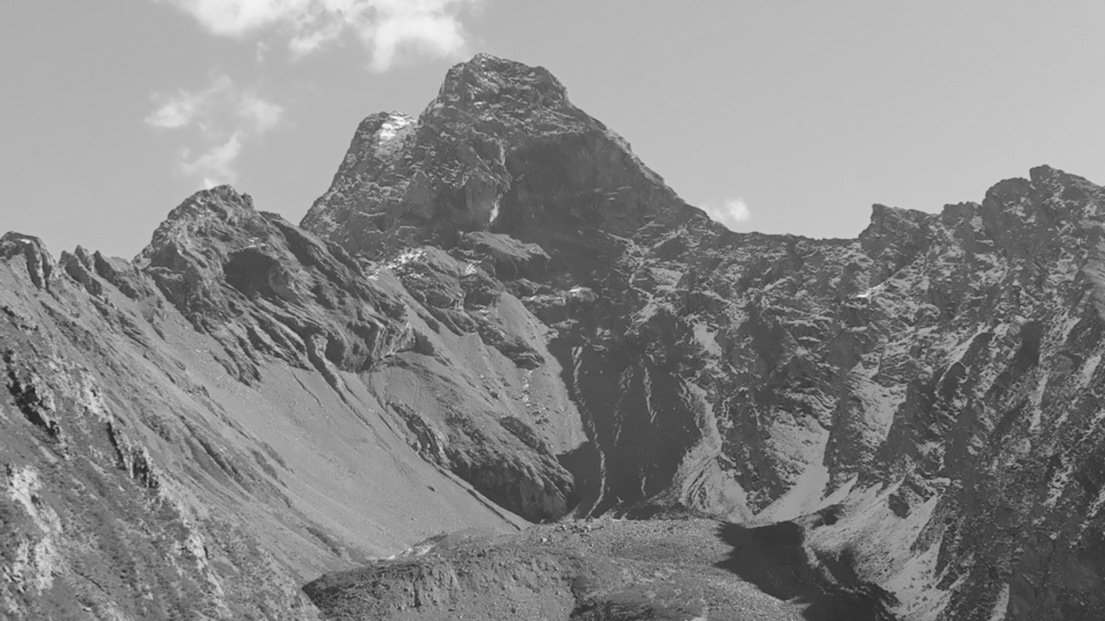
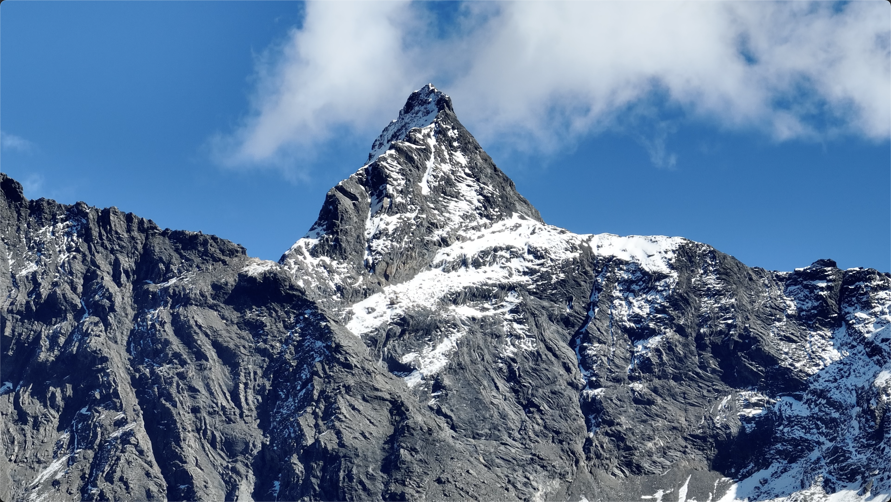
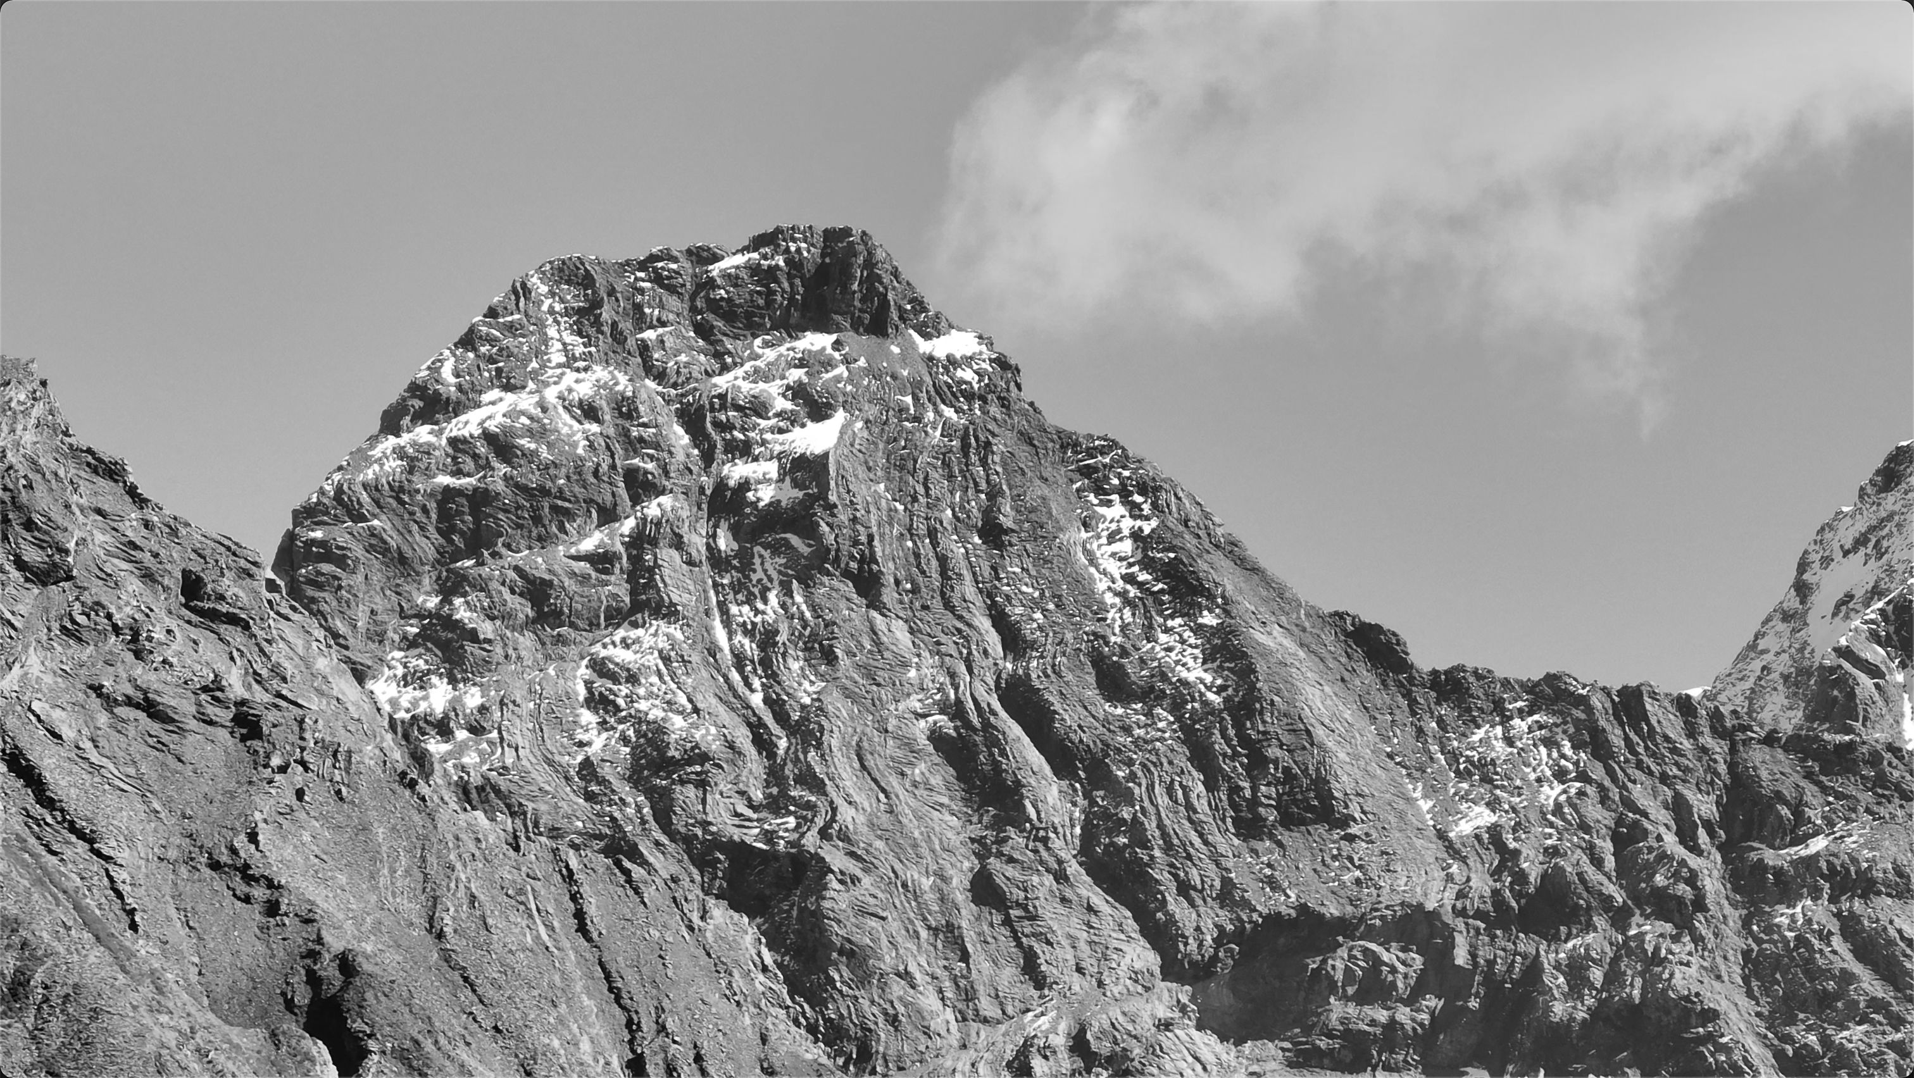
凯乐石未登峰计划攀登申请书
An application for unclimbed-peak project of Kailas
2022年11月
November 2022
攀登者：王永鹏（小牦牛）、杨晟(小五)、张浩、吴云贺（阿鹤）
climbers：Yongpeng Wang(the Yak), Sheng Yang(Xiaowu), Hao Zhang, Frank Wu(Ahe)
山峰在召唤，我必前往之
Mountains are calling

Slide 2
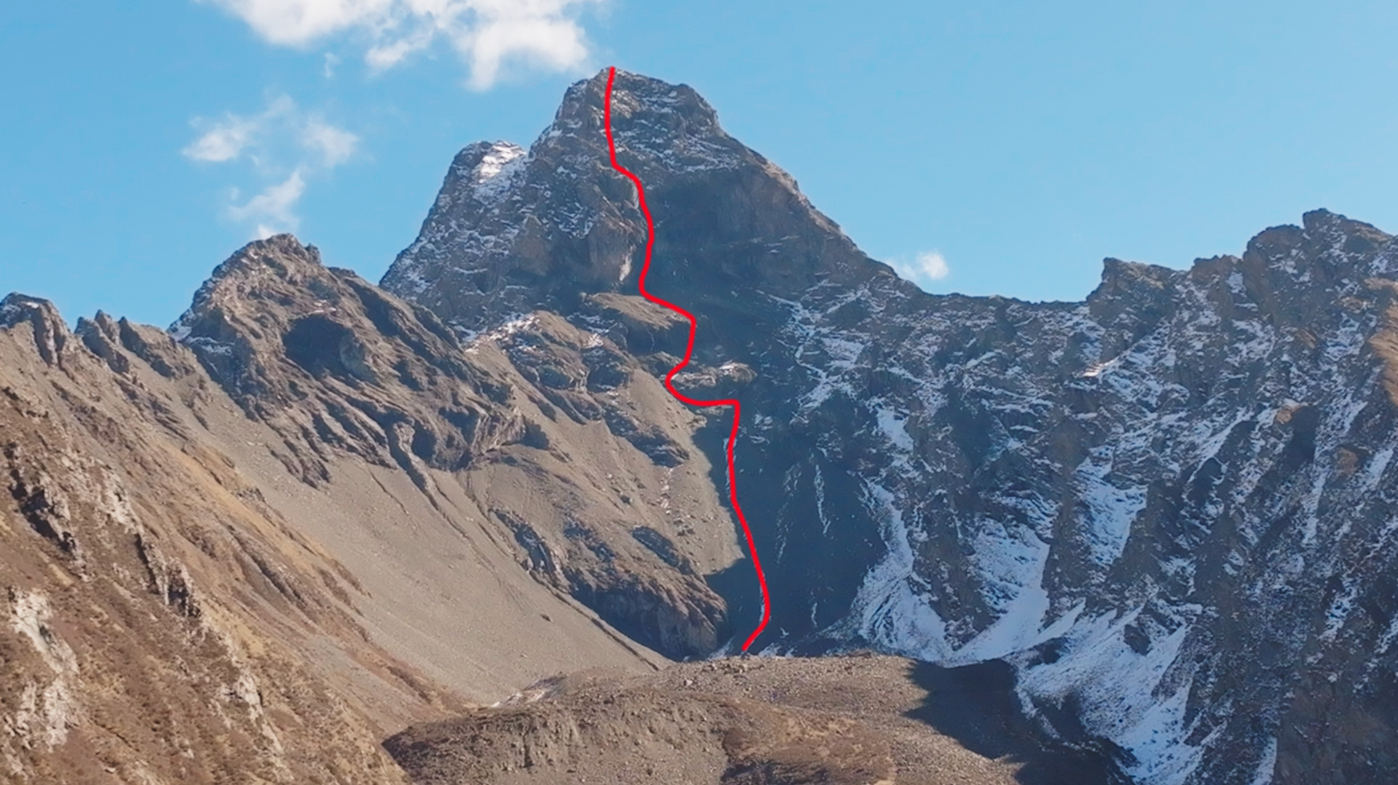
卡热神山/Sacared Mountain Kare
位于四川阿坝藏族自治州小金县结斯沟向花村内
属于横断山脉邛崃山系的一条分支
海拔高度为5100m+，
属于岩石为主，季节性覆雪
目前在网上没有查询到攀登信息，属于未登峰
It is located in Xianghua Village, Jiesi Valley, Xiaojin County,
Aba Tibetan Autonomous Prefecture, Sichuan
It is a branch which belonging to the Qionglai Mountains
of the Hengduan Mountains
The altitude of it is around 5,100 meters
The terrace of it is rock-dominated, snow-covered seasonally
And it still remains an umclimbed peak

Slide 3
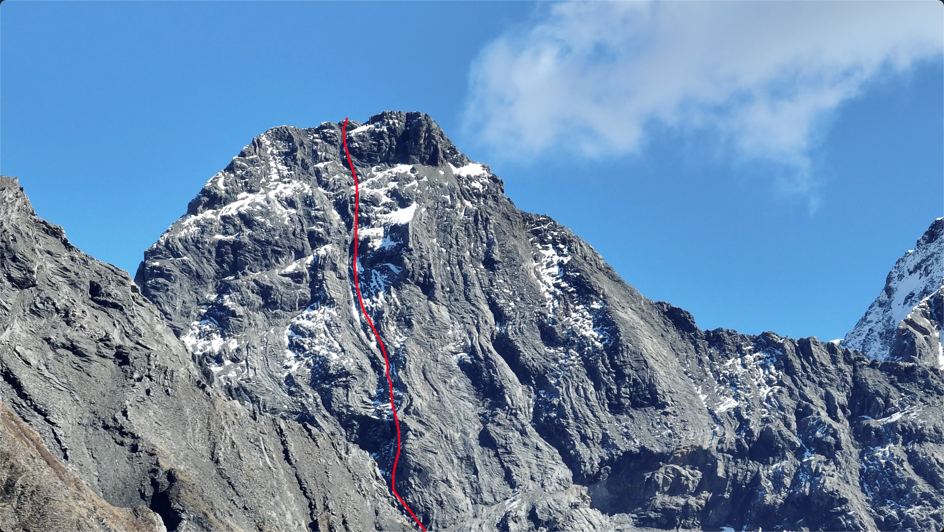
无名峰1/Unknown Peak no.1
位于四川阿坝藏族自治州小金县结斯沟向花村内
属于横断山脉邛崃山系的一条分支
海拔高度为5100m+，
属于岩石为主，季节性覆雪
目前在网上没有查询到攀登信息，仍是一座未登峰
It is located in Xianghua Village, Jiesi Valley, Xiaojin County,
Aba Tibetan Autonomous Prefecture, Sichuan
It is a branch which belonging to the Qionglai Mountains
of the Hengduan Mountains
The altitude of it is around 5,100 meters
The terrace of it is rock-dominated,
snow-covered seasonally
And it still remains an umclimbed peak

Slide 4
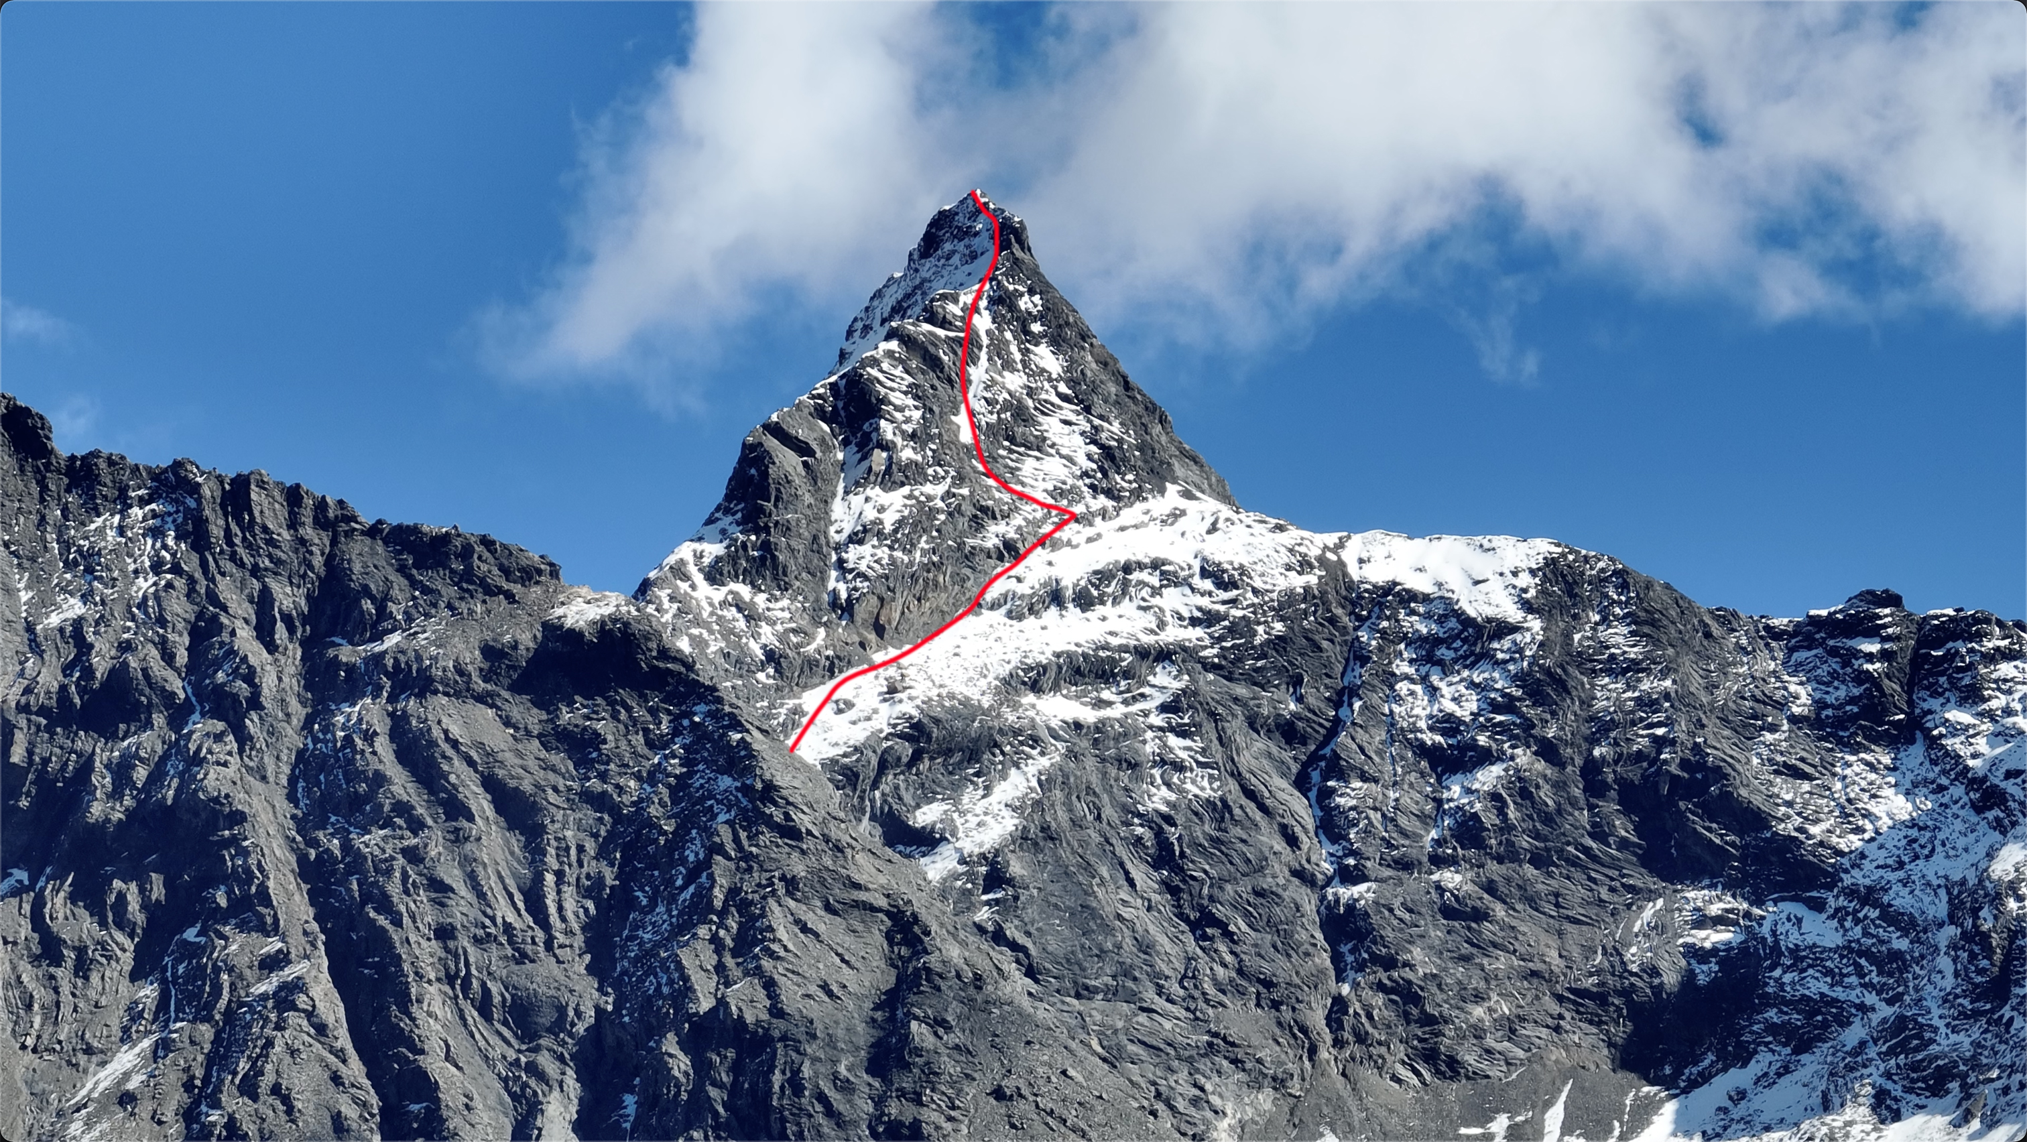
无名峰2/Unknown Peak no.2
位于四川阿坝藏族自治州小金县结斯沟向花村内
属于横断山脉邛崃山系的一条分支
海拔高度为5100m+，
属于岩石为主，季节性覆雪
目前在网上没有查询到攀登信息，仍是一座未登峰
It isLocated in Xianghua Village, Jiesi Valley, Xiaojin County
Aba Tibetan Autonomous Prefecture, Sichuan
It is a branch belonging to the Qionglai Mountains
of the Hengduan Mountains
The altitude of it is around 5,100 meters
The terrace of it is rock-dominated,
snow-covered seasonally
And it remains an umclimbed peak

Slide 5
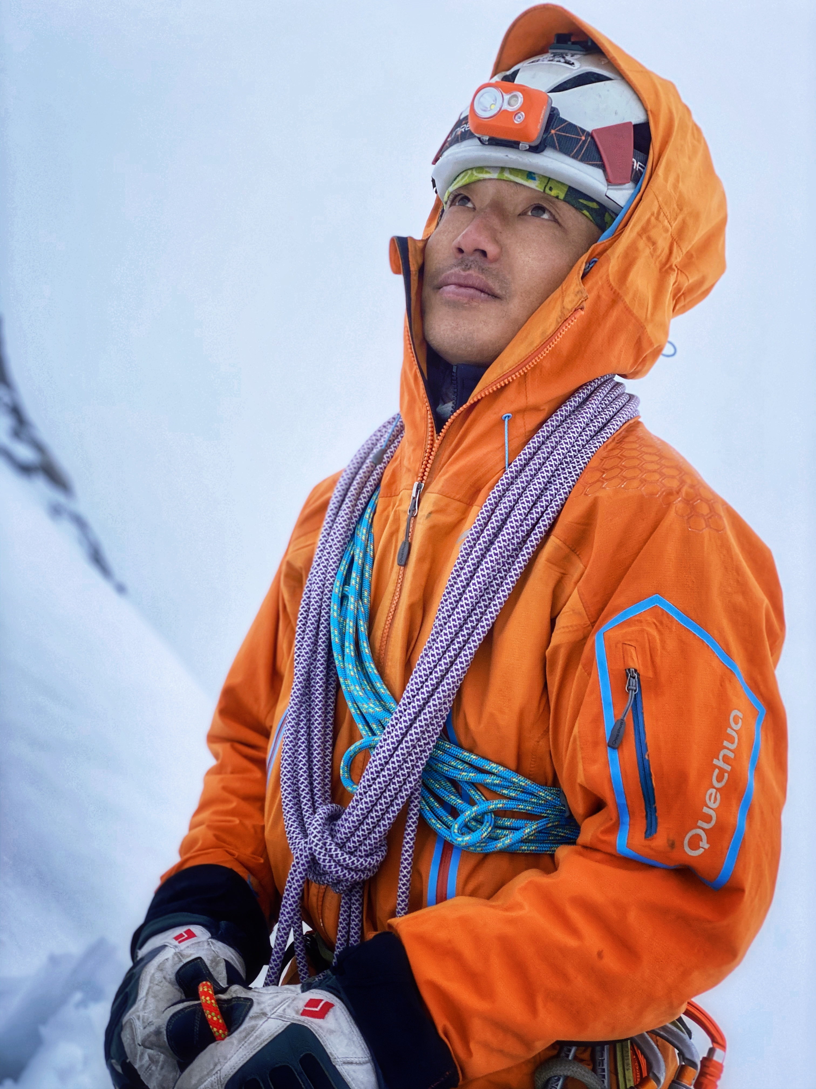
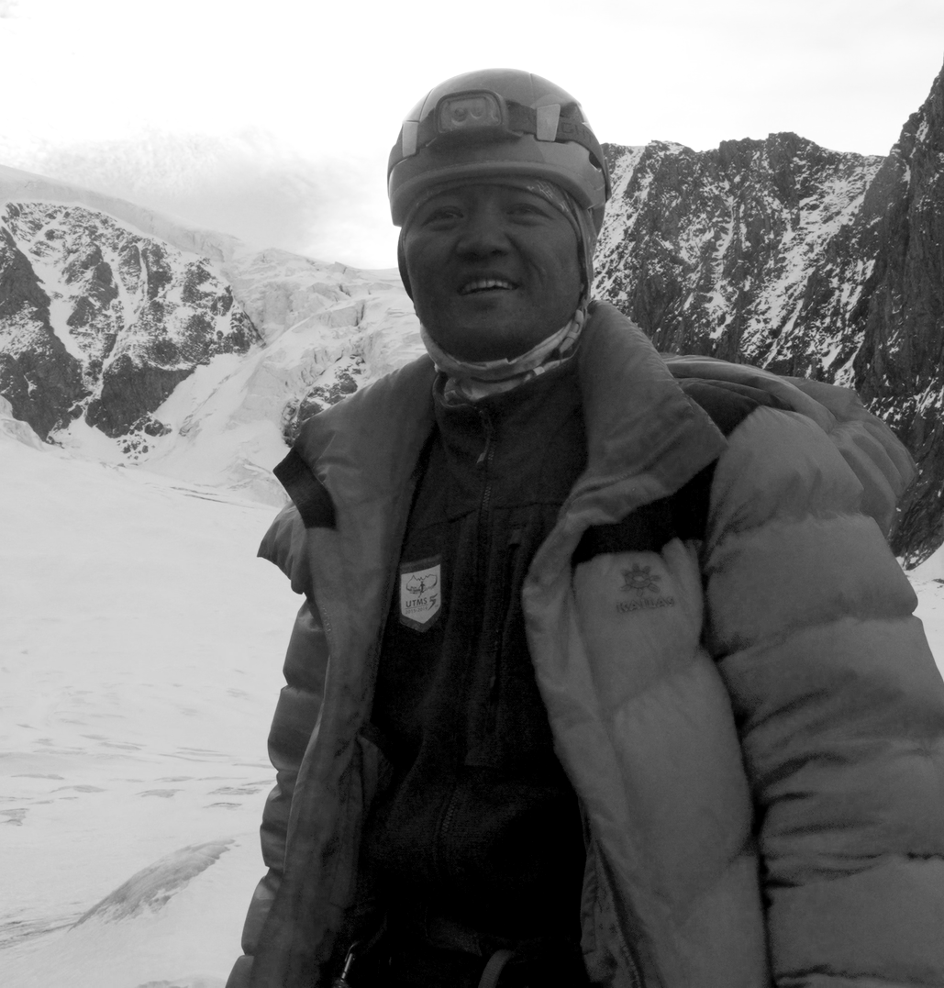
杨晟（小五）
Shengyang (Xiaowu)
29岁/ born at 1993
王永鹏(小牦牛）
YongPeng Wang (the yak）
32岁/ born at 1990
12年职业登山向导，
川登协持证向导
8年职业登山向导，
川登协持证协作，
中登协户外指导员
As a mountaineering guide with 12 years experiences
Sichuan Mountain Asociation moutaineering guide certificated
As a mountaineering guide with 8 years experiences
2020年金犀牛最佳攀登成就获得者
China Mountain Asociation outdoor guide certificated
2020 Golden Rhino Best Climbing Achievement Winner
Sichuan Mountain Asociation moutaineering assitant certificated
2021年11月登顶幺妹峰：南壁中央直上
2022年11月小贡嘎传统路线登顶
2021/11 Peak. Yaomei: South Face, Free Spirit
2022/11 Mt. Little Konka: SouthEast Ridge, tranditional route
2021年9月份中山峰传统路线登顶
2020年9月登顶婆缪峰：自由扶梯
2021/09 Mt. Zhongshan: traditional route
2020/09 Peak. Pomiu: Free Ladder
2020年10月日乌且卫峰首登
2020/10 Mt. Riwuqie Secondary peak: FA, three routes
2019年10月开辟阿妣峰新路线：突破，中央直上
2018年10月勒多曼因传统路线登顶
2019/10 Peak. Abi: South Face, Breakthrough
2018/10 Mt. Reddomain: traditional route
攀登能力/Ability of Climbing：
攀登能力/Ability of Climbing：
攀冰/Ice-Climbing： WI5
攀冰/Ice-Climbing： WI4
攀岩/Rock-Climbing： 5.11B
攀岩/Rock-Climbing： 5.10B

Slide 6
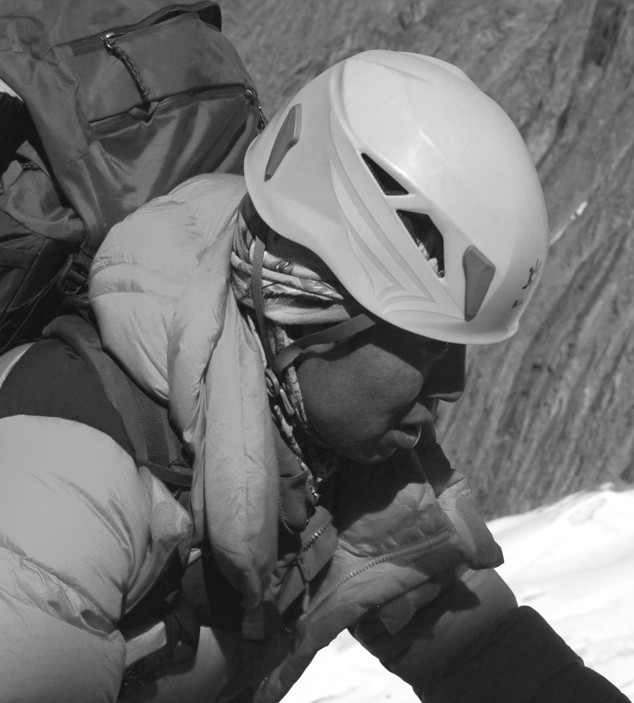
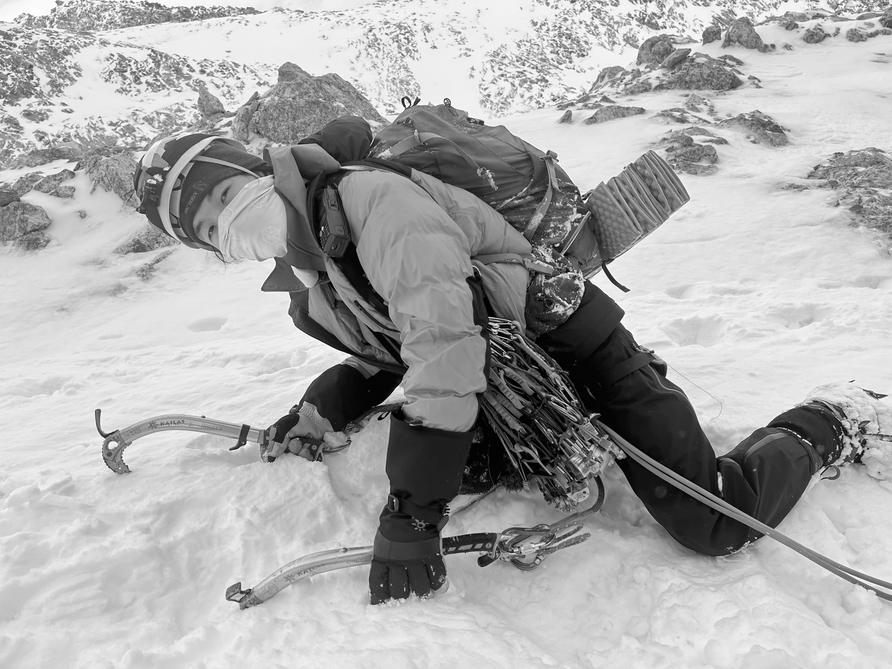
张浩
吴云贺(阿鹤)
Hao Zhang
Yunhe Wu (Ahe)
38岁/ born at 1984
25岁/ born at 1997
4年摄影师，1年高山向导
As a photographer with 4 years experiences
4年职业登山向导，
川登协持证协作，
As a mountaineering guide with a year experience
Sichuan Mountain Asociation moutaineering assitant certificated
2022年11月小贡嘎传统路线登顶
As a mountaineering guide with 4 years experiences
2022/11 Mt. Little Konka: SouthEast Ridge, tranditional route
2022年8月牛心山南壁新路线：要穿攀岩鞋
2020年10月日乌且卫峰首登
2022/08 Mt. Ox Heart: South Face, new route: need climbing shoes
2021/09 Mt. Riwuqie Secondary peak: FA, three routes
2022年8月四姑娘山三二山脊
2022/08 Mt. Sanfeng and Mt. Erfeng of Siguniang: ridge
4年带队经验：乌库楚、那玛峰、大玛雅等
2022年8、5月雪宝顶、乌库楚登顶
4 years as a mountaineering guide, Mt.WukuChu, Mt. Nochma,
Mt. Damaya etc.
2022/08 and 2022/05 Mt. Xuebaoding and Mt. Wukuchu
攀登能力/Ability of Climbing：
攀登能力/Ability of Climbing：
攀冰/Ice-Climbing： WI3+
攀冰/Ice-Climbing： WI3
攀岩/Rock-Climbing： 5.11D
攀岩/Rock-Climbing： 5.10A
传统攀/Trad-Climbing： 5.10+

Slide 7
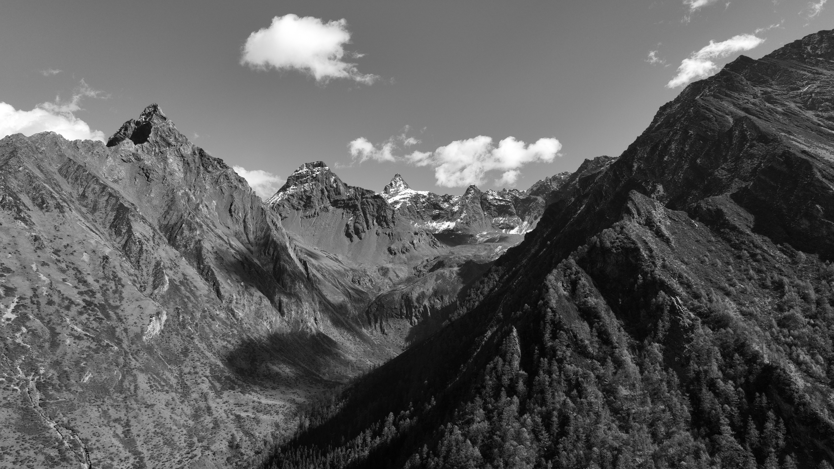
攀登计划/Climbing Plan
攀登装备/Gears we Need
头部：气旋头盔*4、羊毛双面针织帽*4
上身：mont-x pro冲锋衣*4、7000gt厚羽绒*4、GT ZERO羽绒*4
滑雪保暖内衣一套*4
下身：skimont滑雪登山冲锋裤*4
手足：登山手套GORE（薄）*4、登山手套麦金利（厚）*4
越野跑鞋Fuga Du*4、高山靴*4
技术装备：Entheos II技术镐一对（铲头+锤头）*4、
8.5mm登山半绳60m * 4、Vacau快挂18cm*40、机械塞一套*4
登山超轻主锁*40、Dyn扁带环120cm*20、7mm辅绳*100m
苍穹背包*4、 Tabary 超轻攀登安全带*4
露营装备：蜻蜓超轻露营帐篷*2、高山4人帐篷*2、温标-20℃睡袋*4
其他：驼包*4
BC营地打算设置在4500m海拔处，
随后一日冲顶后下撤的阿式攀登风格
BC camp is planned to be set at an altitude of 4,500m meters
And will use one-day push alpine style at the following day
攀登时间/Date for Climb:
2022/11/24 ~ 2022/12/05
是否需要攀登许可/Registration Needed?: 是/Yes
拍摄计划/Will take a short film?: 是/Yes

Slide 8
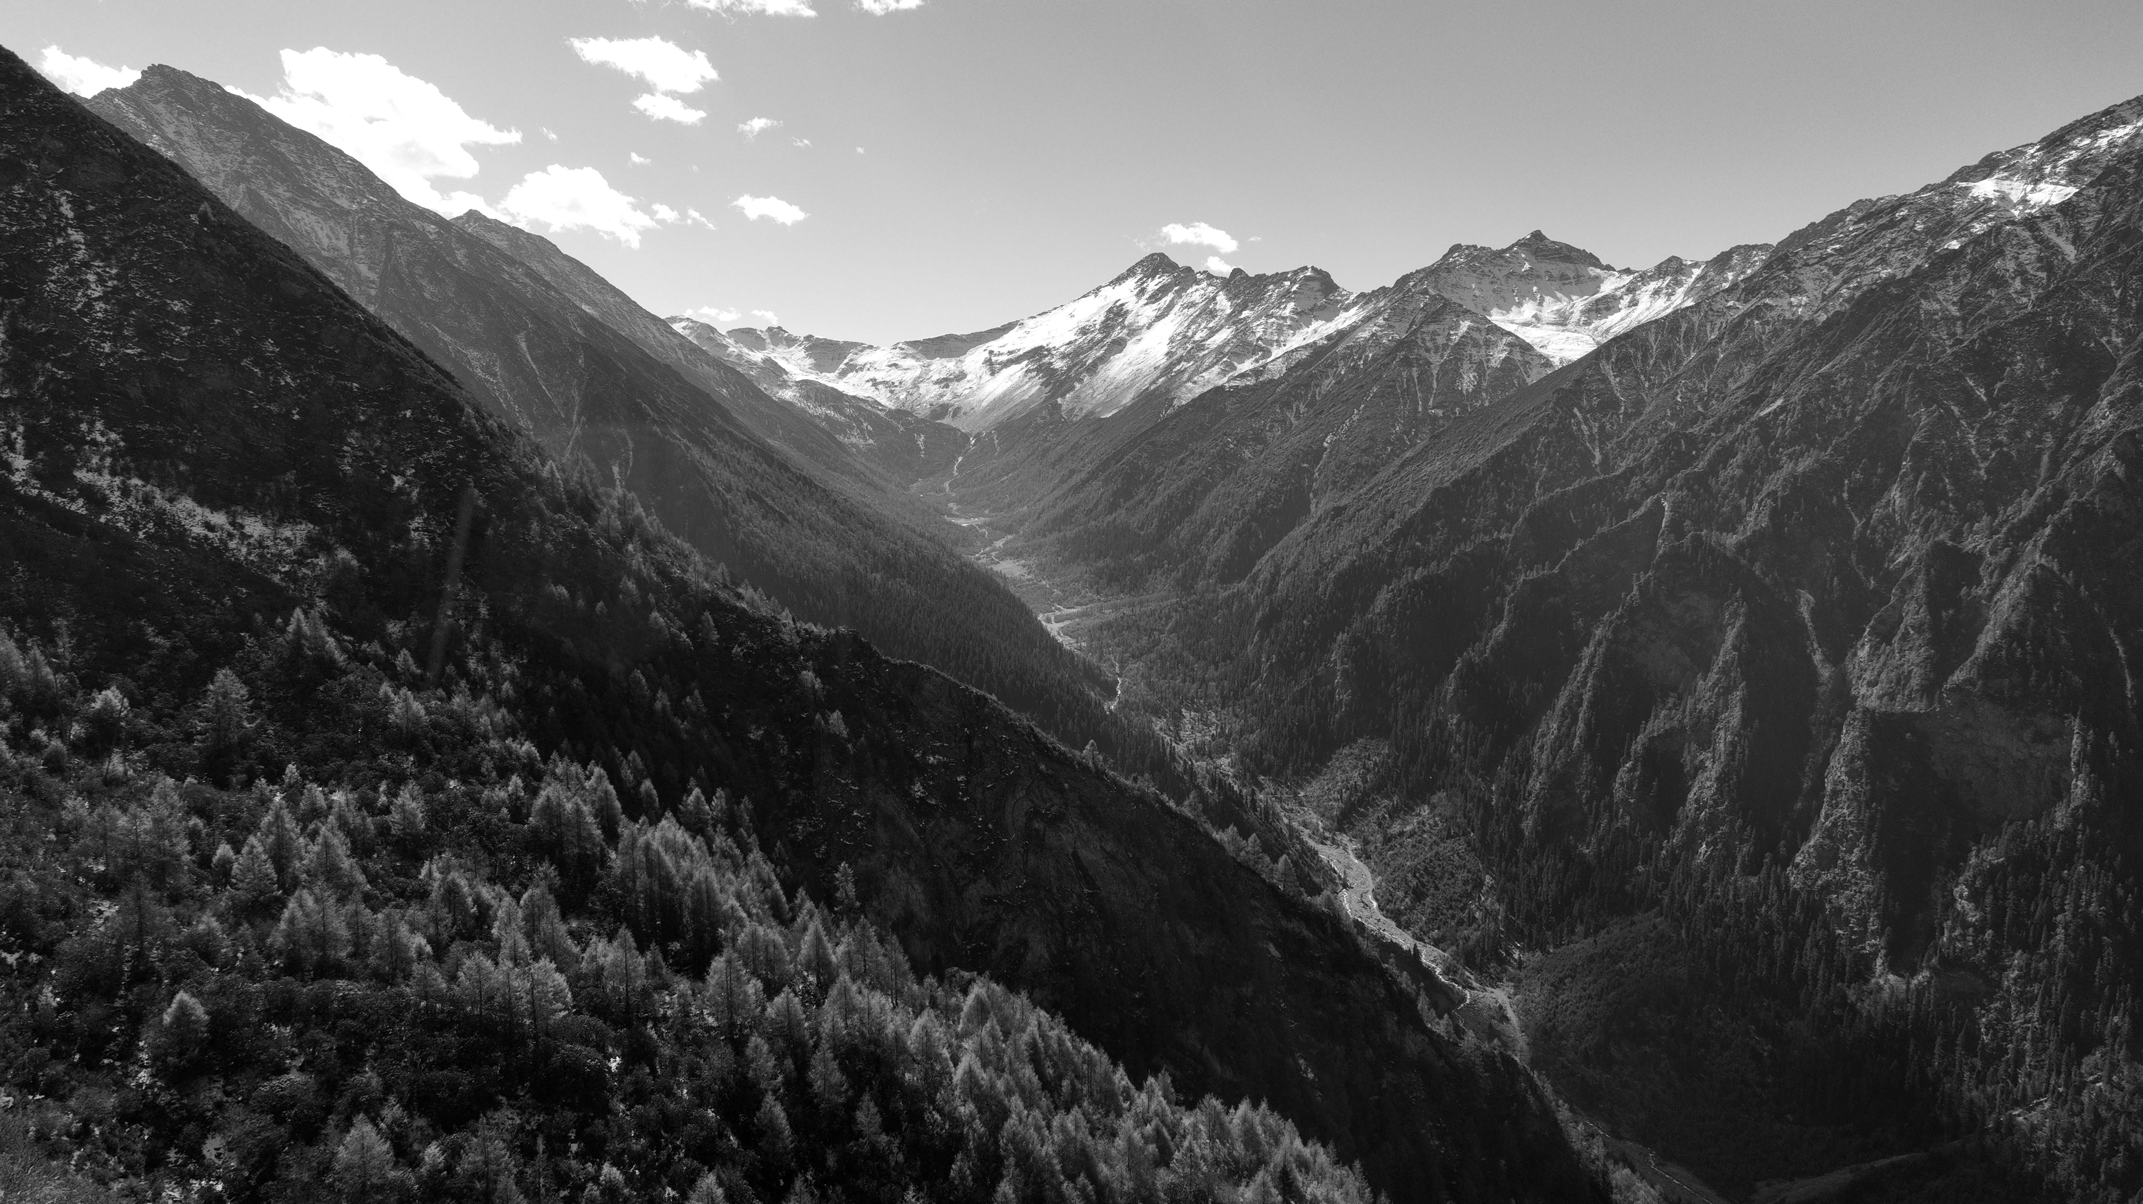
THANKS FOR WATCHING
谢谢观看
©️All copyright reserved to Frank Wu

